Slide 1
Thompson Sampling
Siddharth Ajit and Mason Rumuly
for ECEN 689-606

Slide 2
Outline
Multi-Arm Bandits
Exploration, Exploitation, and Regret
Bernoulli Distribution
The Beta Distribution and Modeling Uncertainty
Sampling Algorithm
Demo
Performance Guarantees
Variants

Slide 3
Multi-Arm Bandits
Royalty-free Picture of slot machines
Generally number of actions (or ‘arms’) with some probabilistic reward
Must take the action to learn about it
Objective: find arm with greatest expected value and use it
Mention some applications

Slide 4
Multi Arm Bandit Problem
Consider a slot machines with N arms
At each step t = 1, 2, 3 ……. , one arm is played.
When an arm i is played, there is a probabilistic reward r_{i(t)}
corresponding to the arm.
Probability distribution of rewards P(r|i) is unknown.
The random reward associated with each arm are i.i.d and do not depend on the rewards of the other arms.
The reward value is observed as soon as the arm is played

Slide 5


Objective
Design an optimal strategy to maximize the expected value of rewards after T finite steps
Equivalently, minimize the expected regret function, where r* is maximum value of r_{i}

Slide 6
MAB Examples
Financial investment – Given a fixed amount of cash flow, what is the optimal policy to maximize the returns over a period of time.
Clinical trials – Find the best possible treatment option from many other possible options while minimizing harmful effects for the patient.
Add another example

Slide 7
Exploration and Exploitation
Exploration : Gain or learn more information about the rewards by pulling all the arms; gather more information to improve future decisions.
Exploitation : Maximize the reward or minimize the regret by pulling the arms with greatest expected value; Make the best decision given the existing information.
In the context of MAB, the user must take action (play an arm) to learn about it. In short, sub optimal actions should be chosen to maximize long term benefits.

Slide 8
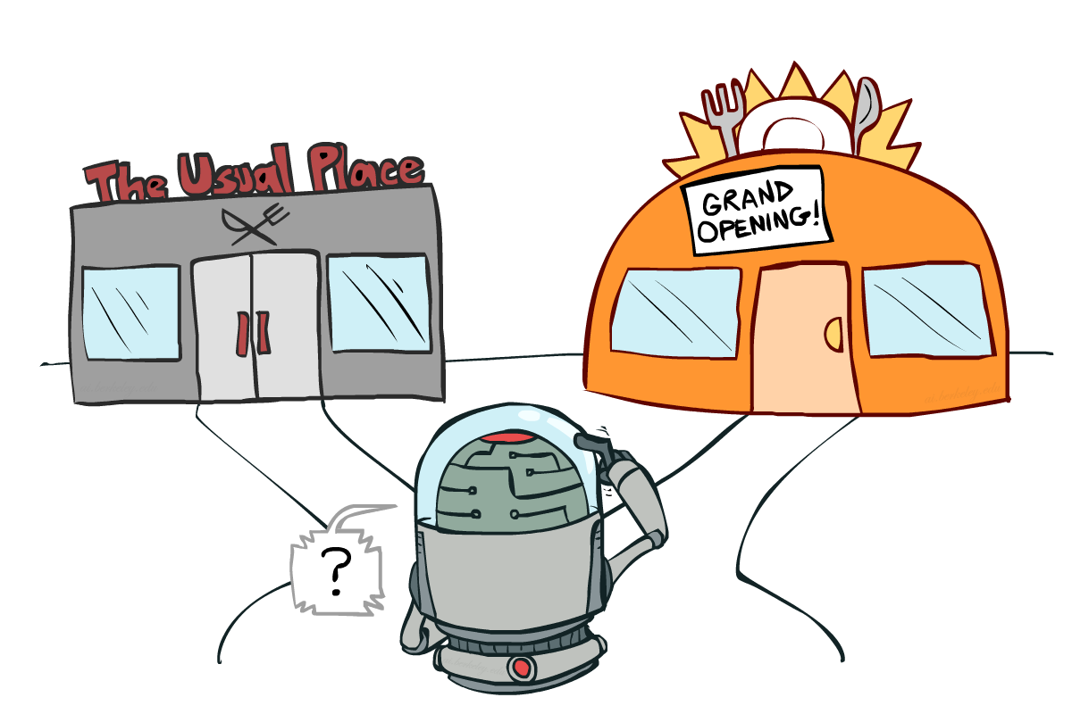
Example

Slide 9
Example Cont’d
Explore : Visit the new restaurant to learn about it. You may like the new place and hopefully visit it more often or regret your decision
Exploit : Go to the usual favorite restaurant and “exploit” the utility or value associated with the decision. You may lose out on finding a better restaurant

Slide 10
MAB Summary
To summarize, the MAB problem is a finite resource allocation problem where the objective is to maximize total returns.
The returns of different allocation choices are unknown or partially known before the allocation
The returns of the choices are updated as time passes or more actions are taken

Slide 11

MAB : Problem description
P1
P2
P3
The reward takes two discrete values : 0 and 1
Assume that the reward follows a Bernoulli distribution
“Insert latex equation of Bernoulli”

Slide 12
Beta distribution
The uncertainty about the parameter θ is expressed as a beta distribution
“Insert pdf of Beta” ???
What is alpha and Beta here ?
Reason for choosing Beta

Slide 13
MAB problem strategies
No exploration : A naïve approach, often yields sub-optimal results
Exploration at random
Algorithmic exploration - ϵ -Greedy Selection, UCB arm selection, Thompson sampling

Slide 14
Sampling Algorithm
[reference 1930’s paper]

Slide 15
Demo

Slide 16
Performance Guarantees
[reference log(n) regret proof papers, convergence to true expected values and optimal policy]

Slide 17
Variants
[Beta Distribution formulations, choice of priors, Dirichlet for multi-outcome]

